Slide 1

STOCK ASSET SELECTION
By S. Chin’ombe, W. Chipangura, T. Kachepa & I. Madhara

Slide 2
Project Overview
Goal:
- Predict and recommend the top performing stocks monthly.
Stakeholder Needs:
- Dashboard-ready predictions.
- Actionable 'Buy/Sell/Do Not Enter' recommendations.

Slide 3
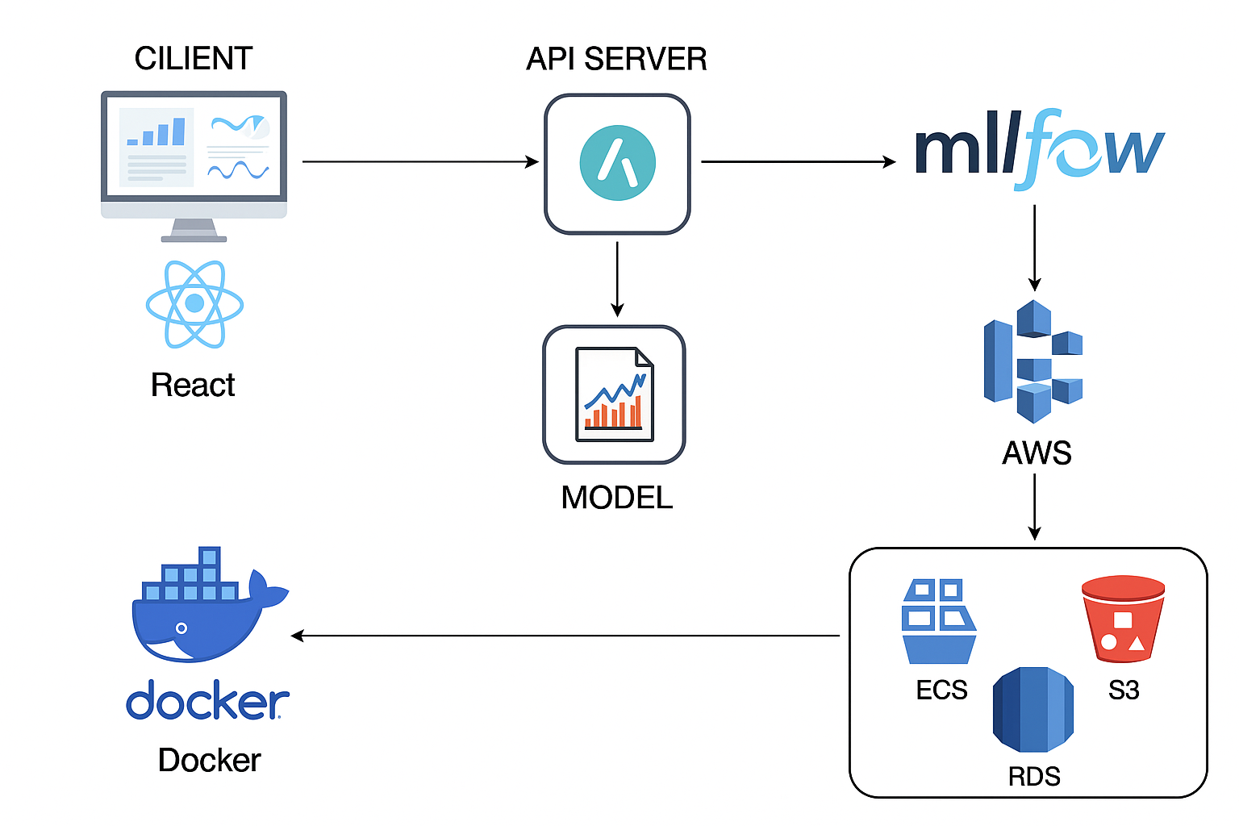
Architecture

Slide 4
Technical & Fundamental Analysis
Market Data Source: Yahoo Finance
From 01/01/2015 to 04/30/2023 was used for training
Notes:
Yfinance library on python

Slide 5
Model Selection
Target Variable Type: Continuous. Therefore,
Random Forest Regressor
Why? A robust non-linear model that handles complex relationships between features.
Pros: Handles non-linearity, reduces overfitting through ensembling, and aids in feature selection via feature_importance_.
Cons: Can be slow and relatively less accurate

Slide 6
Feature Selection & Engineering
Technical:
5-day Return, 20-day Return, Volatility
RSI (14-day), MACD, MACD Signal
Bollinger Bands
Fundamentals:
PE Ratio, PB Ratio
Notes:
Might be a good idea to mention by rank
Made use of the ta library
5-day Return: Captures short-term momentum.
20-day Return: Indicates medium-term trend.
20-day Volatility: Measures risk and instability.
RSI (14-day): Detects overbought or oversold conditions.
MACD & MACD Signal: Captures trend-following momentum shifts.
Bollinger Bands High/Low: Identify price extremes and volatility compression.
PE Ratio: Reflects valuation (high PE may imply overvaluation).
PB Ratio: Measures asset-based valuation.
Combined different aspects of stocks to make the prediction robust

Slide 7
Evaluation & Metrics
R² Score: 0.3134
MAE: 0.0469
MSE: 0.00398
RMSE: 0.0631
Notes:
R² shows overall model strength.
MAE and RMSE make the error size easy to communicate.
MSE highlights whether we have problematic large outliers.
R² Score (Coefficient of Determination): 0.3134
Measures proportion of variance explained by the model.
Closer to 1 is better.
MAE (Mean Absolute Error): 0.0469
Average magnitude of errors.
Easy to interpret: "on average, our prediction is off by about 4.69%."
MSE (Mean Squared Error): 0.00398
Squares errors, heavily penalizing large mistakes.
Useful to emphasize outliers.
RMSE (Root Mean Squared Error): 0.0631
Square root of MSE, back to original units.
Interpreted similarly to MAE but more sensitive to large errors.

Slide 8
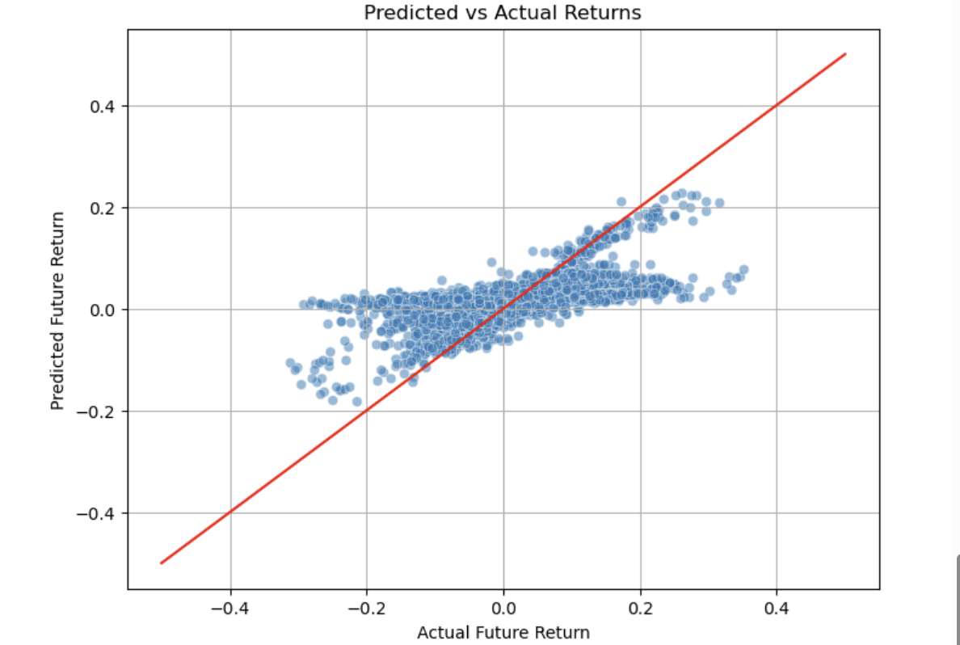
Model Evaluation Visuals

Slide 9
Sentiment Analysis
News Data: Source:NewsAPI Query: Recent articles mentioning over the past 30 days
Stock Price Data: Source:Yahoo Finance Timeframe: Last 30 days to ensure overlap with news data

Slide 10
Feature Engineering
Return
Direction
Sentiment Score (sentiment)
4. Price Features (Open, High, Low, Close)
5. Volume
Notes:
1. Return Feature (return)
Definition: Percentage change in stock price from the previous day's close.
Rationale: Captures recent volatility and serves as an important contextual signal for sentiment-driven price impact.
2. Next Day Return (next_return)
Definition: The return value for the next trading day (shifted target).
Rationale: Acts as the regression label to train models predicting future price movement magnitude.
3. Direction Label (y_mov)
Definition: Binary variable indicating whether the stock went up or down the next day.
Rationale: Enables classification modeling for movement direction (UP/DOWN) instead of raw price change.
4. Sentiment Score (sentiment)
Definition: Composite score combining two sentiment calculations:
tfidf_score: Weighted average of financial keywords using TF-IDF.
financial_score: Average score of sentiment-heavy financial terms.
Combined using: tfidf_score and financial_score
Rationale: Quantifies how positively or negatively news is expected to impact stock prices. Adjusted weighting favors direct keyword matches for reliability.
5. Price Features (Open, High, Low, Close)
Definition: Daily open, high, low, and close prices of AAPL from Yahoo Finance.
Rationale: Provide context for intraday volatility, market range, and end-of-day investor behavior. These are foundational signals in financial modeling.
6. Volume
Definition: Total number of shares traded for the day.
Rationale: Indicates the level of market participation and interest, often spiking on high-sentiment or news-driven days.

Slide 11
Model Selection
XGBoost was selected for classification tasks based on its performance and suitability for structured financial data.
Non-linear modeling
Robustness
Speed
Notes:
XGBoost was selected for both regression and classification tasks based on its performance and suitability for structured financial data.
Justification:
Non-linear modeling: XGBoost handles complex relationships between price and sentiment features.
Robustness: Performs well with noisy, real-world financial data.
Speed: Efficient for training and tuning even on moderately sized datasets.
Interpretability: Offers feature importance to help understand model behavior.

Slide 12
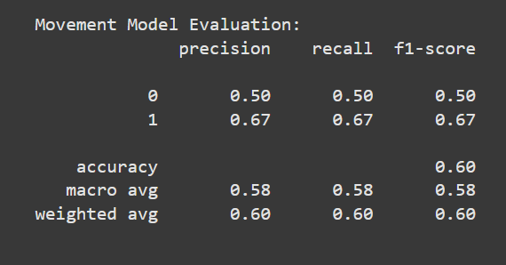
Evaluations
Notes:
Class 0 (DOWN)
Class 1 (UP)
The model performs moderately well, especially on predicting UP days.
Performance on DOWN days is weaker, likely due to:
Small dataset (only 5 samples)
Possible class imbalance (3 ups, 2 downs)

Slide 13
Demo

Slide 14
KPI’s
Financial Performance Metrics:
Directional Accuracy
Hit Ratio
Operational Metrics:
Model Drift
Notes:
Financial Performance Metrics
Directional Accuracy: Percentage of times your model correctly predicts whether a stock will go up or down
Hit Ratio: Percentage of profitable trades from your model's recommendations
Operational Metrics
Signal Stability: How consistent are your model's recommendations over time?
Model Drift: Is performance degrading over time? Model drift refers to the degradation of model performance over time as the relationship between inputs and outputs in the real world changes. Can be data driven by change of market conditions

Slide 15
Challenges
Financial markets are influenced by unpredictable factors and the data has got a lot of noise.
Access to premium data isn’t free.
Notes:
Challenge 1: Stock Data Has a Lot of Noise
Stock prices are highly volatile due to market sentiment and external events. This makes it hard for models to distinguish real patterns from random movements. To address this, use smoothing techniques, technical indicators, and robust ML models like LSTM or Random Forests.
Challenge 2: Access to Premium Data Isn’t Free
High-quality financial data often requires expensive subscriptions (e.g., Bloomberg). Free sources like Yahoo Finance or Alpha Vantage have limits in accuracy and frequency. Use open APIs, engineer features from raw data, or scrape news content for sentiment-based insights.

Slide 16
Future Work and Improvements
Live Model Retraining
Expand Asset Pool
Stress Test and Robust Backtesting
Explicitly optimize for risk exposure
Integrate pre-trained financial NLP models like FinBERT to improve sentiment accuracy.
Adapt the pipeline to run in real time using a streaming service or API to monitor live headlines and make instant sentiment predictions.
KPI calculation (A function that computes all relevant metrics of the system)
Notes:
1. Live Model Retraining
Enable the model to automatically update with new market data regularly. This keeps predictions relevant and adaptive to recent trends. Use scheduled scripts or online learning techniques for implementation.
2. Expand Asset Pool
Broaden the scope to include more stocks, ETFs, or cryptocurrencies. This improves model generalizability and portfolio diversification. Free APIs can fetch multiple tickers for bulk data collection.
3.Stress Test and Robust Backtesting Run historical simulations across various market conditions (bull, bear, volatile). Validates the model’s resilience under extreme financial scenarios.
4.Explicit Risk Optimization Incorporate risk-adjusted return metrics (e.g., Sharpe, Sortino ratios) into model objectives. Ensures the system doesn’t just chase returns but also controls for downside risk.
5.Use Pre-trained Financial NLP Models (e.g., FinBERT) Boost sentiment prediction accuracy by leveraging finance-specific language models. FinBERT improves contextual understanding of market-relevant news headlines.
6.Real-time Pipeline Integration Build a streaming pipeline using Kafka, FastAPI, or WebSocket-based services. Enables real-time sentiment scoring and instant prediction on live headlines.
7.KPI Calculation Function Create a utility that calculates key performance indicators like accuracy, F1-score, Sharpe ratio, and cumulative returns. Provides a standardized, repeatable way to evaluate and compare model performance.

Slide 17
Conclusion & Recommendations
Predicts top assets reliably but should be used as a decision support system.
It is advised to journal predictions made by the system vs the actual results.
Notes:
The developed intelligent model demonstrates strong potential in aligning with defined trading goals. It reliably identifies top-performing assets using sentiment and historical data. The system is robust and modular, making it ready for real-time dashboard integration and future scalability.

Slide 18
Thank You!
Any Questions?

